Slide 1
Chapter 10 Influencing People
How do I influence people on Facebook and Twitter?

Slide 2
Introduction
What did we learn in last chapter?
exposure to public opinion breaks independence needed for the wisdom of crowds
in ensuing fallacy, people are influenced by actions of others
Viralization is population based scenario
it’s assumed that someone’s public action has the same effect on the next (some random) person regardless of their relationship
maybe influenced by all people who came before me
This chapter studies influence by paying attention to the underlying graph (topology) of social networks (or relationship among people)
The chapter studies topology-dependent aspect of influence

Slide 3
Facebook
Founded in 2004, 1.65 billion people accessed FB at least once in March 2016, which is 1/5 of all people on earth
By 2015/2016, over 4 million posts were being liked, 32 million items shared, and 240,000 photos uploaded to Facebook every minute
Accounting for 30% of all users, the largest age group of FB was 25 to 34, who would have been high school and college-aged when FB emerged in 2006

Slide 4
Friends on Facebook
Facebook’s “friend” feature is the function that made it so popular in the first place
Think about all connections that have been established between people through “add friend” button over the years
These links, and the interactions they enable, bridge the gap between FB as a social media and a social networking site
In 2015/2016, there were 1.5 billion users, and average person had 350 friends. That means the graph would have 1.5 billion nodes, and 1.5 x 350/2 ≅ 260 billion links

Slide 5
Twitter
By Twitter’s 9th anniversary in 2015, it was handling more almost 500 million tweets per day (that’s almost 6,000 per second!)
Twitter tend to spike in usage during major events
During the east-coast earthquake in summer 2011, tweets traveled faster than the earthquake itself from Virginia to New York: 10 seconds (left) and 80 seconds (right) after earthquake

Slide 6
Who Is Important?
Two questions
how can we measure influential power of individuals?
how can we leverage the knowledge of who’s influential and who’s not to actually influence people online?
(1) Quantify a person’s “influence” by
number of followers, number of retweets, number of repostings the person has, etc.
(2) How would a marketing firm use knowledge of influential power to help sell a product?
try to get the product in the hands of the people who are believed to have the most social influence
may incentivize a few influential individuals, or a large number of randomly chosen but reasonably influential people, hoping that when people see them with the product they will decide to buy it

Slide 7
Definitions of Social Importance
How can we measure a person’s importance in a social network?
Start with social graph of the network, where each node is a person
There are many possibilities for what links in a social graph can symbolize (directed or undirected, weighted or unweighted, depending on what we want the graph to represent)
Undirected links represent acquaintance between two persons
Links in Twitter’s graph of following relationships are directed
Measure a node’s importance via its centrality on social graph
How do we “model” a social network among people?

Slide 8
Centrality
Centrality is an index that answers the question "What characterizes an important vertex in a graph?”
Each index is given in terms of a real-valued function on the vertices of a graph, where the values produced are expected to provide a ranking which identifies the most important nodes
Different centrality indices (functions): degree, closeness, betweenness, etc.

Slide 9
Degree Centrality
Degree: the number of nodes connected to the node in question
Degrees of Anna (2), Ben (1), Cara (3), Dana (3), Evan (3), Frank (2)
Cara, Dana, and Evan tied as the most important, followed by Anna and Frank tied as the second most important, and finally Ben as the least important
Is this reasonable?
Ben should probably be the least important: his only connection is to Anna
we can also agree that Dana and Evan are equal in their importance, because they connect to the same people
how about Cara?
without Cara, network is partitioned
should Anna and Cara be more important since they are more vital to graph’s connectivity?

Slide 10
Degree Centrality
One issue degree centrality fails to take into account
if a node is connected to many important nodes, it should probably be more important than if it is connected to many unimportant nodes
PageRank addresses this problem by having each node “spread” its importance to its neighbors

Slide 11
Closeness Centrality
How “far” a node is from its neighbors
Distance between two nodes in a graph = number of links in a shortest path containing them
Path = a sequence of links connecting the nodes, the shortest path is one that uses the fewest possible links
Shortest paths between Ben and Frank is (B, A, C, D, F) with total length 4

Slide 12
Closeness Centrality
Closeness centrality of a node is based on average of shortest path lengths to each of the other nodes
Nodes for which this is small tend to be closer to other nodes and are thus more “important”
The links on and the lengths of the shortest paths for Cara
Average =
Smaller average → higher closeness

Slide 13
Closeness Centrality
Closeness centrality of a node is based on average of shortest path lengths to each of the other nodes
The links on and the lengths of the shortest paths for Dana
Average =
Small average → higher closeness
Cara
1 1
3 2
5 3
Compared to degree centrality, several ties have been broken by closeness centrality
Cara’s and Anna’s scores are justified by fact that they are both vital to graph’s connectivity
2 1
2 1
4 2

Slide 14
Closeness Centrality
Closeness centrality is quite intuitive
the more people that are close to you, the more central you are to the network
Can we do better?
Still inconsistencies in ranking
why should Anna be less important than Dana and Evan? (Dana and Evan really don’t hold graph together like Anna does)
why is Cara’s closeness only slightly higher than Dana and Evan’s? (she is much more vital to graph’s connectivity)
3
2
4
1
5
2

Slide 15
Betweenness Centrality
Measuring connectedness
Suppose Anna needs to get a message to Frank, over the shortest path possible through network
Two possible paths
tell Cara, who tells Dana, who tells Frank
tell Cara, who tells Evan, who tells Frank
In either case, she needs to tell Cara. But then Cara has two possibilities: Dana or Evan
If you were to assign importance “scores” with respect to Anna’s message to Frank, how would you do it?
Cara may get the most, since both paths involve her
only one of the two paths involve Dana or Evan, so they may each get half of what Cara is awarded

Slide 16
Betweenness Centrality
What if Ben wants to send a message to Dana?
There is only one shortest path: send to Anna, who forwards to Cara, who passes to Dana
How shall we reward scores to Anna and Cara?
Anna and Cara may get the same amount
How many should they get relative to what we gave Cara, Dana, and Evan before (Anna → Frank)
Previously there were two possible paths, but now there’s only one, making it more critical
without Anna or Cara, Ben couldn’t message Dana
likewise, without Cara, Anna couldn’t message Frank

Slide 17
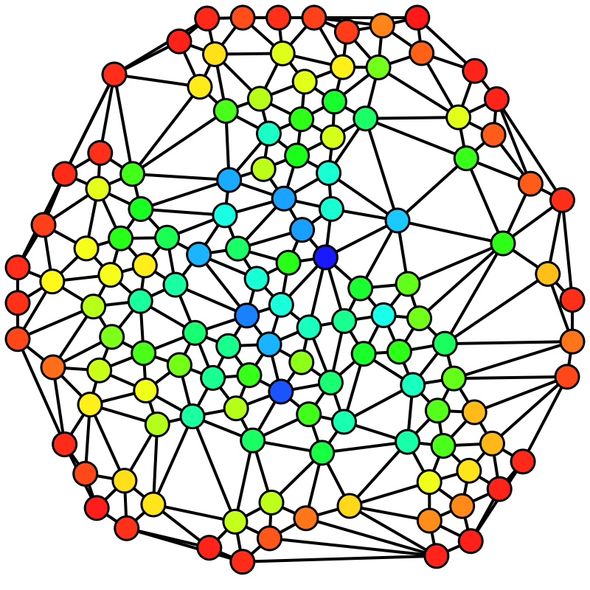
Betweenness Centrality
from red = 0 to blue = max
Betweenness centrality
quantifies the number of times a node acts as a bridge along the shortest path between two other nodes

Slide 18
Betweenness Centrality
Considers a node to be more important when it lies on more critical paths between other nodes in network
If 3 shortest paths from A to B, and 2 of them contain C, then what would C be awarded for this pair?
2/3
For pair Anna and Frank,
Cara is awarded 2/2, and Dana/Evan awarded ½
For pair Ben and Dana
Anna/Cara each gets 1/1 (since there is only one shortest path)

Slide 19
Betweenness Centrality
Consider Betweenness centrality of Cara
By intuition, will Cara’s Betweenness centrality be high or low?
High, because she holds the two sides of the graph together
You probably know someone like her in your social network
Consider each pair of nodes in graph, except those with Cara
how many shortest paths are there between the pair?
how many of these shortest paths contain Cara?

Slide 20
Betweenness Centrality
Anna and Ben: How many shortest paths are there? Just one, link (A, B). Does it contain Cara? No, so she gets 0/1 = 0 points
Anna and Dana: How many shortest paths? One, (A, C, D). Does it contain Cara? Yes. She gets 1/1 = 1 point
Anna and Evan: Again, there’s one shortest path, (A, C, E). Since it contains Cara, she again gets 1/1 = 1 point
Anna and Frank: How many shortest paths? Two: (A,C,D,F) and (A, C, E, F). How many with Cara? Both, so she gets 2/2 = 1
Ben and Dana: There’s one shortest path, (B, A, C, D). And it contains Cara, so she gets 1/1 = 1 point
Ben and Evan: Again, there’s only one shortest path, (B, A, C, E), and it contains Cara, so she gets 1/1 = 1 point
Ben and Frank: How many paths? Two: (B, A, C, D, F) and (B, A, C, E, F). Since both contain Cara, she gets 2/2 = 1 point
Dana and Evan, Dana and Frank, Evan and Frank: Each of these pairs has one shortest path, (D, E), (D, F), and (E, F). None of them contain Cara, so she gets 0/1 = 0 points for each

Slide 21
Betweenness Centrality
Degree centrality is really rather naive, whereas closeness and betweenness will lead to rankings that better match our intuition about, and potential use of, who is important
Which one to use depends on goal of using a centrality measure

Slide 22
Centrality
Betweenness
Closeness
Degree
Notes:
A) Betweenness centrality, B) Closeness centrality,, D) Degree centrality, of the same graph.

Slide 23
Influencing Socially through Contagion
Investigate how a person’s social relationships can influence her to adopt a product, service, or item
Each neighboring node is in one of two “states” regarding whether she has adopted some product, service, or item: “Y” means yes, while “N” means no
Do the four nodes in the “Y” state present enough social influence to cause the center node to flip (i.e., to adopt the item) as well?
Some of your friends bought iPhones (and change to “Y” state)
The more people you see that have it, the more influence that will have over you, and the more likely you will want to get one too
Is there a way for us to tell whether or not you will follow suit in the end?

Slide 24
Influencing Socially through Contagion
Define flipping threshold for each node
Fraction of a node’s neighbors that must have already flipped before that node will as well
E.g., 50% (4/8) of the center’s neighbors have flipped. So if her threshold is less than 50%, she would get the item too, but if it is something higher, then she wouldn’t, because there is not enough social influence
E.g., if her threshold is 80%, how many neighbors should flip before she does?
at least 7 of her friends to have adopted it (since 7/8 > 0.8, but 6/8 is not)

Slide 25
Influencing Socially through Contagion
Realistically, flipping threshold is hard to estimate, as it depends on a lot of different factors
one factor is item itself: “cheaper” and “more attractive” items would tend to lower threshold
Another is individual: Bob could be relatively easy to sway, following suit as soon as one or two of his friends has, whereas Alice may never budge
network factors: strength of social ties between people, and what a “link” represents
In following discussion, assume that we know the flipping threshold, and that it’s the same for each of the nodes in graph

Slide 26
Contagion – 1st Step
In each time iteration, go through person by person to see if their flipping thresholds have been met, and if so, switch them to Y
Anna: initially, one of her neighbors is flipped (Charlie), and the other is not (Dana). Since exactly 50% have, Anna has been presented with just enough social influence, so she will
Ben: one has (Charlie), and the other has not (Dana). 50% is enough, so he will flip
Dana: we just determined that two neighbors will flip. But, that doesn’t happen until end of this round: at this point, none of her neighbors have flipped. With 0% influence, she will not either
Eve: one of her neighbors has flipped (Charlie), and the other four have not. How much influence does she see then? 1/5 or 20%. Since this is less than 50%, it is not enough
Frank, George, and Hannah: none of their neighbors have flipped
Assuming a threshold of 50%, how will the graph change over time? – a process termed contagion

Slide 27
Contagion – 2nd and 3rd Steps
2nd step
Dana: two neighbors (Anna and Ben) have flipped, and two have not (Eve and Frank). 50% is just enough influence for her to flip
Eve, Frank, George, and Hannah: the situation hasn’t changed
Eve: two neighbors have flipped, and the other three haven’t, making 40%. Not quite enough
Frank: one of his neighbors has flipped, and the other three haven’t. This makes 25%. Again, not enough influence
George and Hannah: still, none of their neighbors have flipped
So, none of the nodes switch state in 3rd iteration
3rd step

Slide 28
Contagion – After 3rd Step
Why none of the nodes switch state in 3rd iteration?
Because each of these nodes has too many neighbors who have not flipped, and not enough who have
out of Eve, Frank, George, and Hannah, Eve has the highest fraction of links to those in “Y” state, and influence on her is only 40%
These four nodes form a social cluster that is too dense to be penetrated from outside
Eve has 60% of her neighbors inside the cluster, Frank 75%, and George and Hannah 100%
density is the smallest of these, or 60%

Slide 29
Strategic Marketing: Maximize Collective Influence
Connection between contagion and strategic marketing
maximize the amount of people who will buy our product by choosing the right people to seed it with in the first place
What measures can we take to get more people to flip?
lowering flipping threshold
breaking clusters: cut social ties from within to penetrate them from outside
seeding nodes inside clusters to introduce social influence from inside
Which of these are feasible/doable?
changing thresholds would require us to change peoples’ preferences
breaking links would call for changing social relationships
these are factors that a marketing company doesn’t have control over
pay nodes in clusters to adopt the product

Slide 30
Strategic Marketing: Maximize Collective Influence
Suppose each person can be influenced with a certain amount of money
Presumably, those nodes that perceive themselves as more influential will require more money
a designer company might pay a famous celebrity a large sum of money to wear its clothing brand
under a total budget constraint, which nodes should we seed in order to maximize the extent of flipping at equilibrium, while perhaps minimizing the time it takes to reach this equilibrium?
It would be great to trigger positive feedback like we had for sequential decision making in Chapter 9, where our seed set influences nodes to flip, creating enough influence to cause even more to flip, creating even more influence, and so on

Slide 31
Strategic Marketing: Maximize Collective Influence
If we can seed just one node, which one?
probably go with the most “important” one based on one of the centrality measures
In general, we don’t want to choose the most “central” nodes; rather, the objective is to choose those whose “combined” influential power is the largest
Cara is most important in terms of closeness and betweenness
seeding Cara initially (Cara flipped)
after two time steps, Anna and Ben flipped
Can we do better?
seeding either Dana or Evan initially
all nodes flip after 5 steps
y
y
y
Centrality measures are not always in line with maximizing influence, which makes it difficult to design a robust solution for the choice of seed nodes

Slide 32
Strategic Marketing: Maximize Collective Influence
How about choosing two nodes to seed?
Two most important by betweenness centrality: Cara and Anna
What would happen?
Actually not much extra from when we just seeded Cara
Does there exist a set of two nodes that will cause the whole network to flip faster than just seeded Dana or Evan (5 steps)?
After one iteration, we cause everyone to flip except Evan
After two iterations, Evan also flips

Slide 33
Conclusion
Choosing based on centrality is not always going to be the best strategy
The important thing is to make sure the nodes we choose will collectively have the most influence
This is not an easy task, especially in realistic social networks that have billions of nodes

